Slide 1
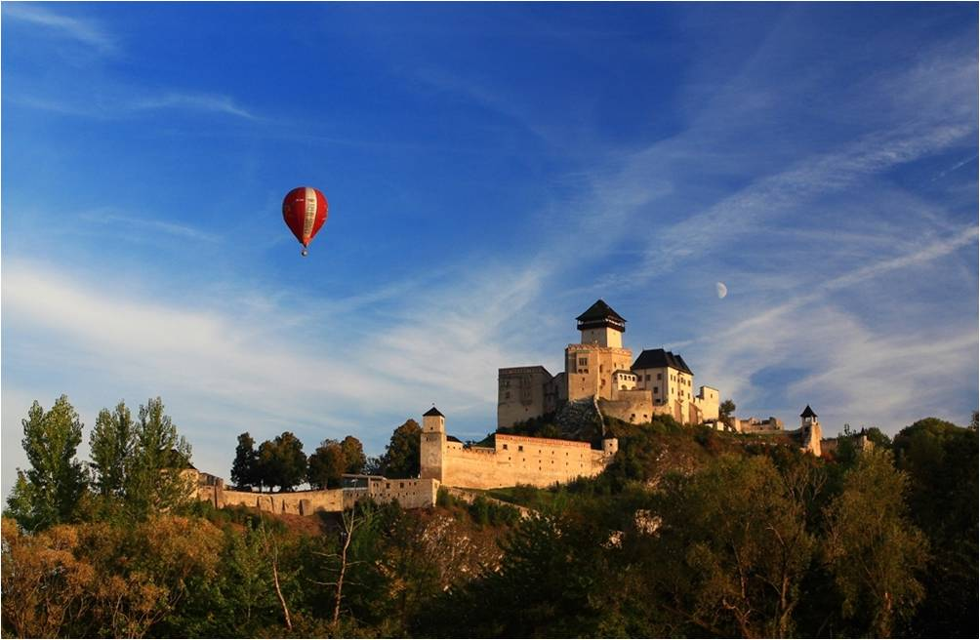
The Self- Governing Region of Trenčín
Visit of Honorary Consuls in Trenčín
20th May 2015

Slide 2
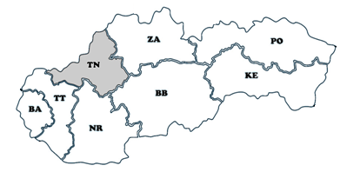
General Information
Slovak Republic is divided into 8 administrative units – self-governing regions or higher territorial units.
The Self-Governing Region of Trenčín is situated in the north-western part of Slovakia.
Poland
Area | 4 500 km2
Population | 592 394
Regional Capital city | Trenčín
No. of districts | 9
No. of towns | 18
No. of villages | 276
Czech Republic
Ukraine
Austria
Hungary

Slide 3
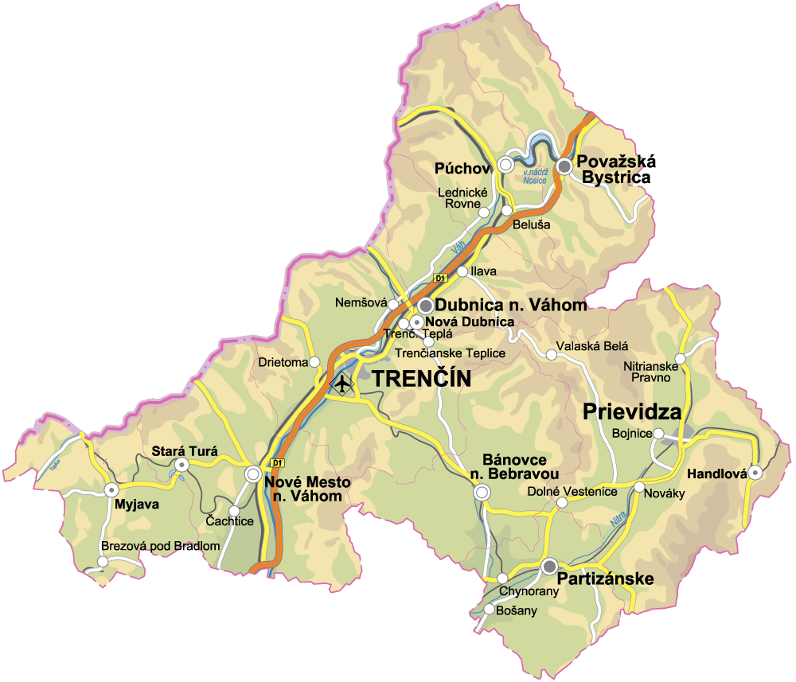
Transport in the Trenčín Region
Road System
The Trenčín Self- Govering Region disposes of high developed network of road communications. The roads are part of :
the international road communications „E“ with the length 188,4 km,
international communications “TEM“ with the length 100,8 km,
multimodal communications and additional corridors TEN-T with the length 87,9 km.
The highway D1 traverses the region in the length 77,9 km.
The R2 speedway between Trenčín and Prievidza is being constructed at the present time.
Railways
There are 10 railways on the territory of the Trenčín Self- Govering Region . Among them, the railways no. 120 and no. 125 are part of the highest transport infrastructure in the hierarchy of paneuropean multimodal corridors ITF (ECMT).
Airports
Trenčín, Prievidza, Slávnica

Slide 4
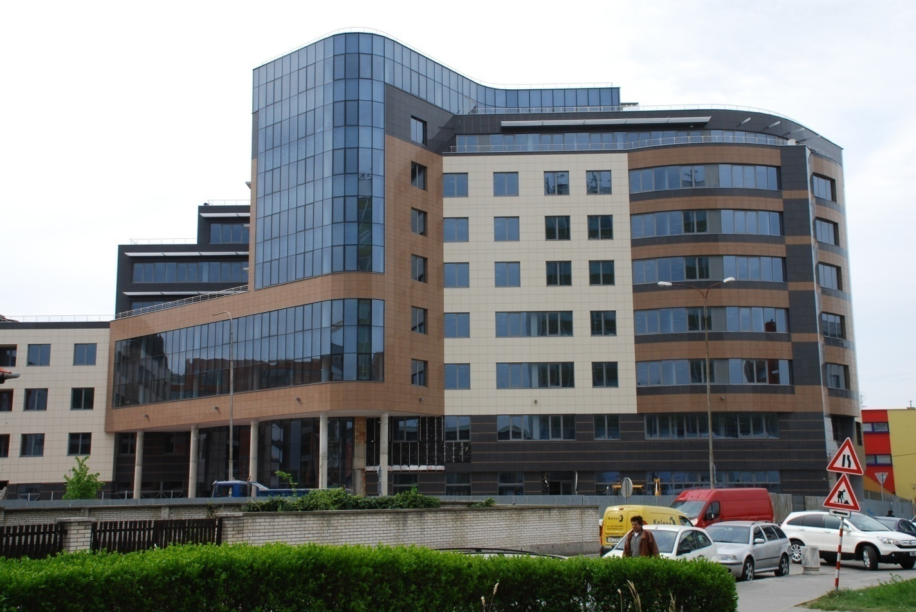
Competencies of the Trenčín Self-Governing Region
Duties of self-governing regions concerns these areas :
Ground Communications
Public Transport
Civil Defense
Social Help
Territorial Planning
Education
Museums and Galleries
Libraries
Health Service
Pharmacy
Regional Development
Tourism

Slide 5
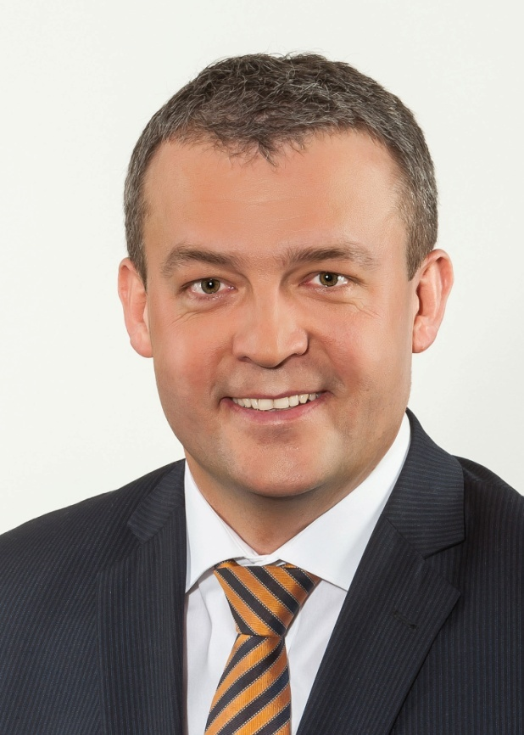
Governor of the Region
The Trenčín Self-Governing Region of is
represented by the governor of the region.
Jaroslav Baška assumed his office of governor of the region of Trenčín
on 9th december 2013
Governor represents self-governing region externally.
Governor is a statutory body in legal property rights and legal employment rights.
Jaroslav Baška

Slide 6
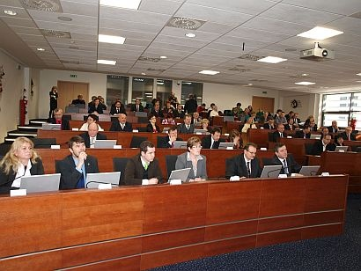
Regional Parliament
Trenčín Self - Governing Region’s Regional Parliament is a body consisting of 45
representatives (MP’s) elected in direct election for the period of 4 years.

Slide 7
Education
No. of Secondary Schools under the Administration of the Trenčín Self- Governing Region | 42
No. of Secondary Students | 19 534 School year 2014/2015
No. of Universities | University of A. Dubček in Trenčín Institut of Technologic in Dubnica n/Váhom City University of Seattle in Trenčín

Slide 8
Secondary Vocational Education
Agreements on Cooperation - The Trenčín Self-Governning Region initiates signing of agreements on cooperation between secondary schools and eminent employers in order to advance educational process and training of students. In 2014 and 2015 nine agreements on cooperation have been signed.
Centres of Vocational Training and Education - are being created in chosen technical schools to enhance quality of students´ knowledge and practical skills.
Hero of the Craft – In February 2015 the Trenčín Self-Governning Region launched unique project Hero of the Craft which aims to support and promote secondary vocational education and increase an intertest of young people in technical professions.

Slide 9
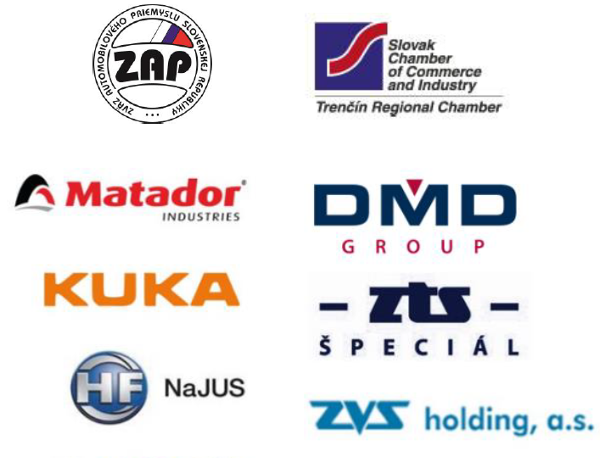
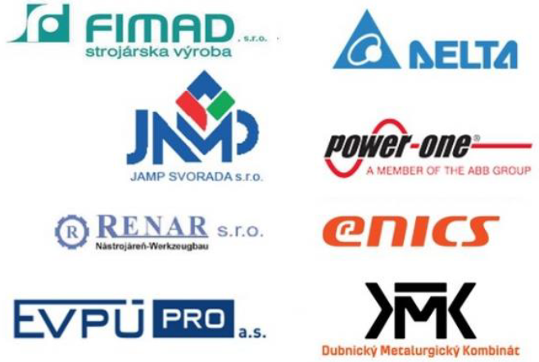
Partners for Secondary Vocational Education

Slide 10
Significant Companies in the Region
Akebono (Japan) - automotive parts and systems
AU Optronics (Taiwan) – LCD panels
Continental Matador (Slovakia)- automotive / tire production
Emerson (Int.) – electrotechnics
Hella (Germany) - automotive parts and systems
Honeywell (USA) – safety products
Johnson Controls ( USA) - automotive parts and systems
Leoni (Germany)– electrical appliance cables
Brose (Germany) - automotive parts and systems
Velux (Int.) - roof windows and skylights
Yura Corporation Slovakia (Korea) - automotive parts and systems

Slide 11
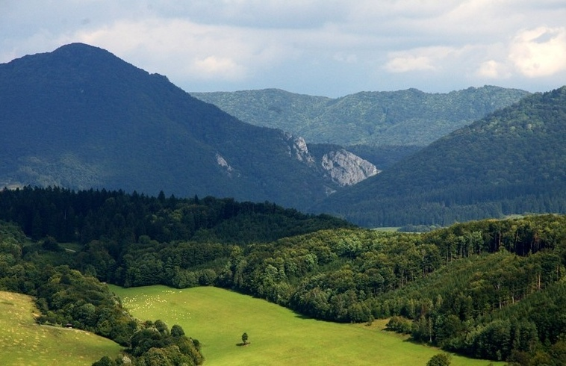
Nature’s Treasures
The Trenčín Self – Governing Region offers ideal conditions for summer and winter stays in nature.
Manínska tiesňava –National Park

Slide 12
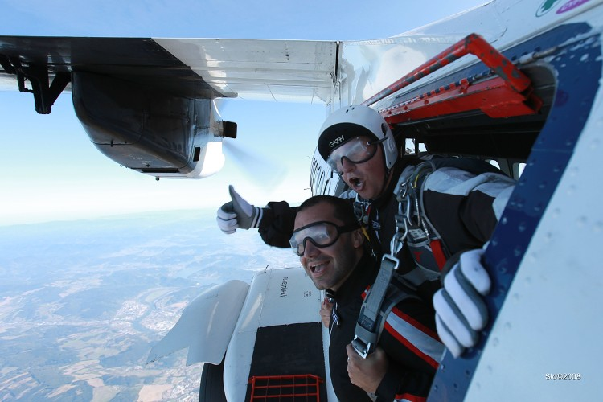
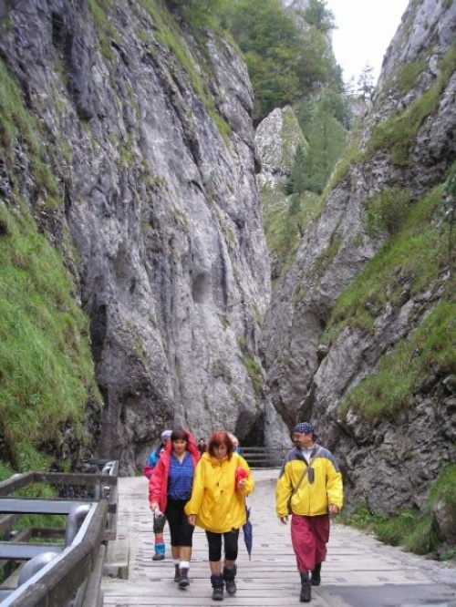
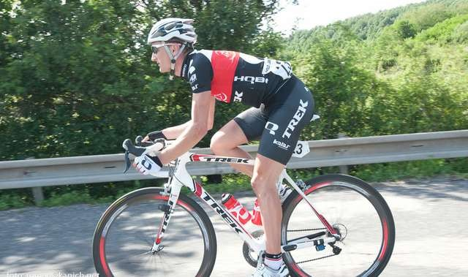
Sport Activities
Cycling
Hiking
Climbing
Extreme Sports

Slide 13
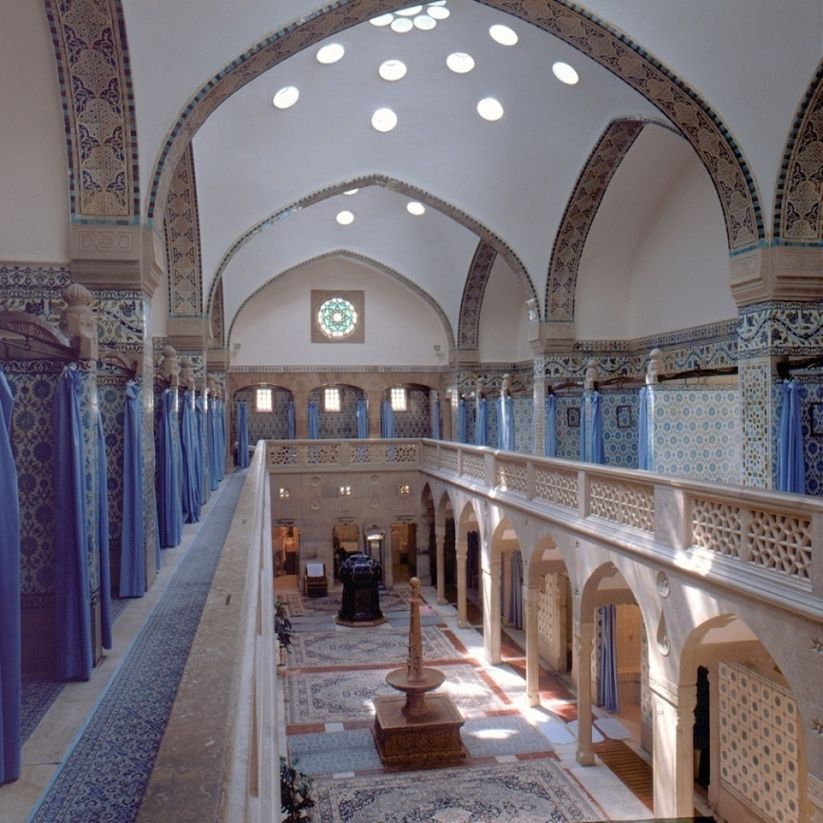
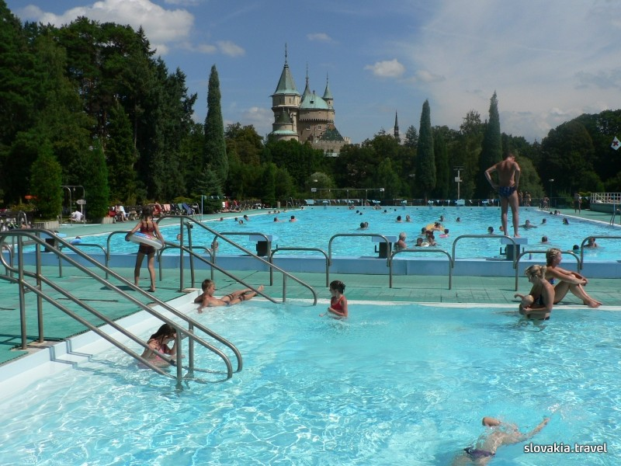
Tourism
Spa House Hammam from 1888 in Trenčianske Teplice
Thermal Swimming Pool in Bojnice

Slide 14
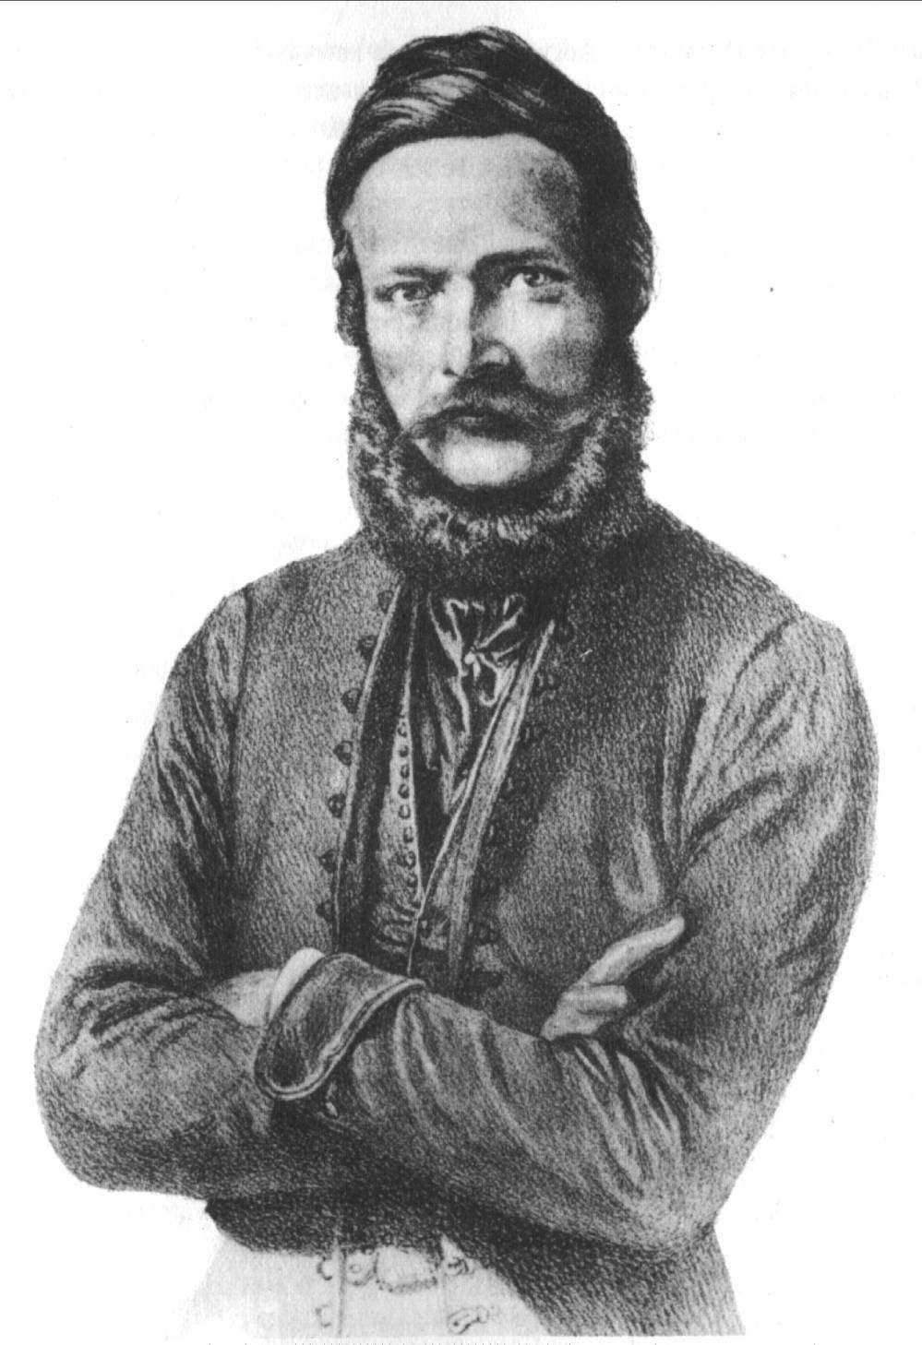
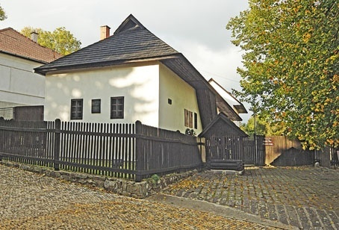
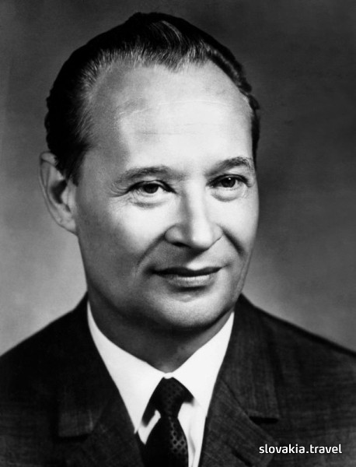
Eminent Natives
Two important personalities of the Slovak history were born in the same house in the village of Uhrovec situated in the Trenčín region: Ľudovít Štúr – a codifier of Slovak literary language and Alexander Dubček - a politician.

Slide 15
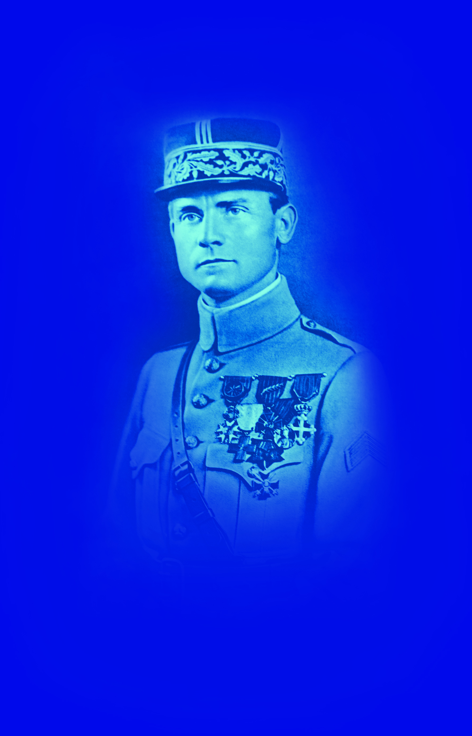
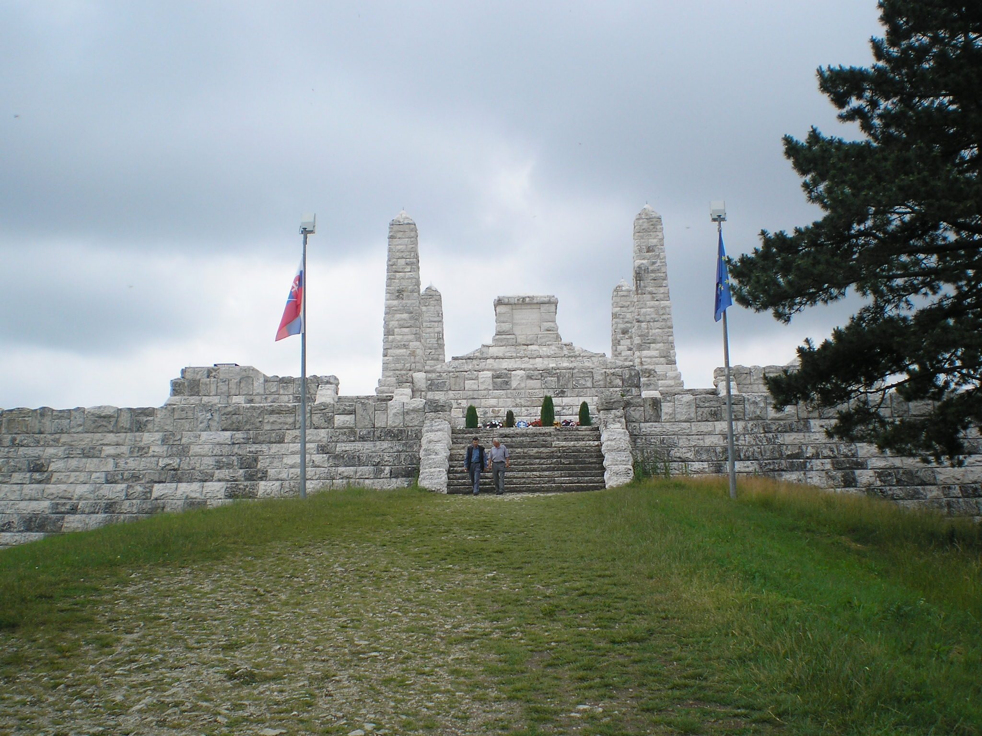
Eminent Native - General M. R. Štefánik
The tomb of general M. R. Štefánik on the Bradlo hill

Slide 16
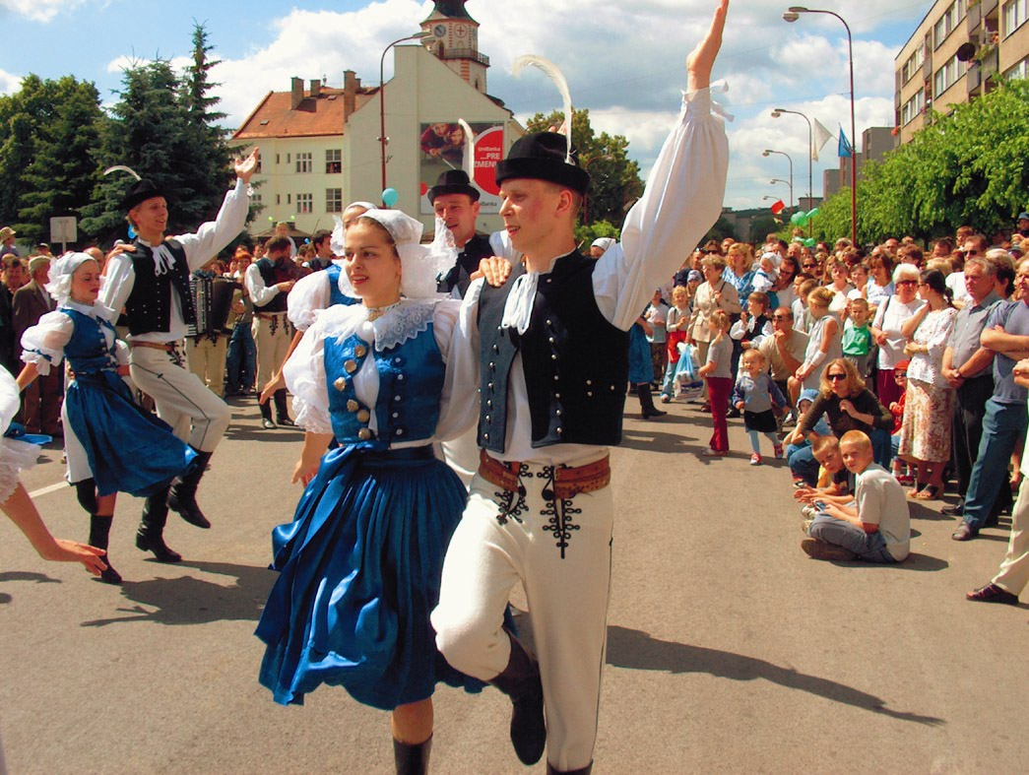
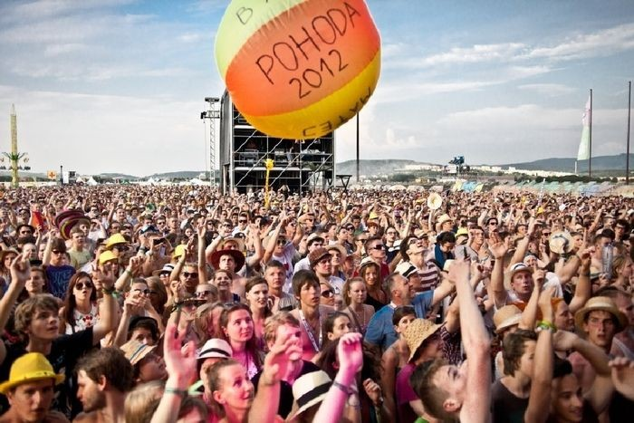
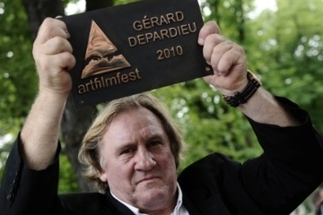
Popular Events
Notes:
16

Slide 17
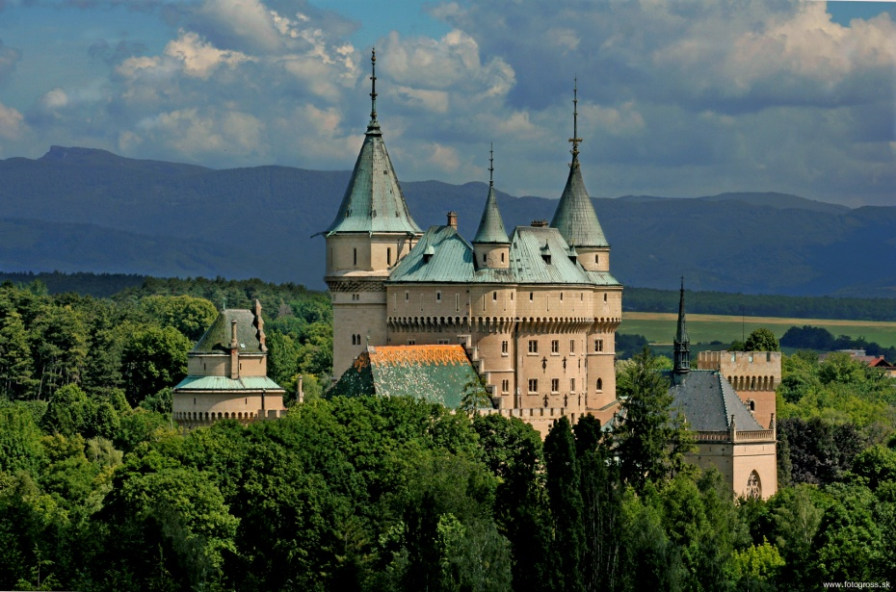
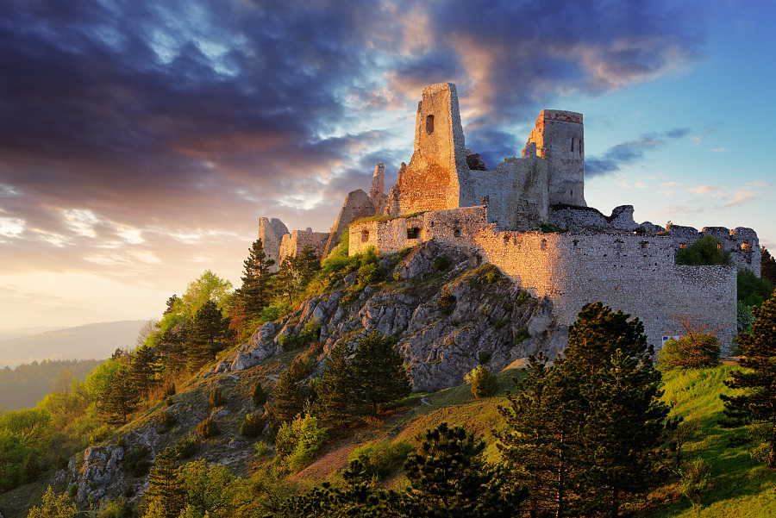
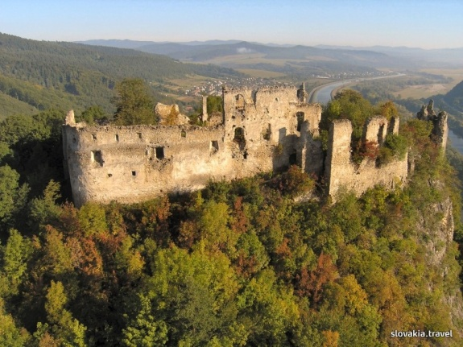
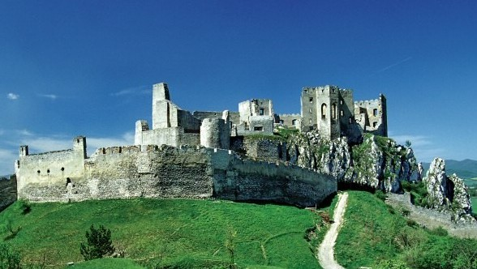
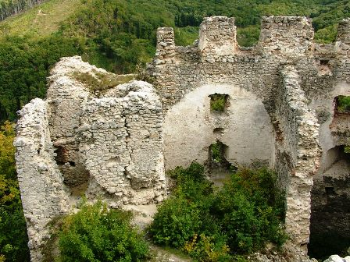
Trenčín Region = Region of Castles and Legends
Bojnice Castle
Čachtice Castle
Považský Castle
Beckov Castle
Tematín Castle

Slide 18
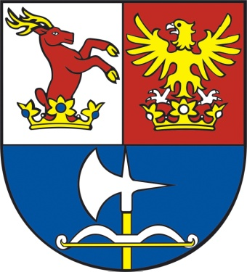
Contact Information
The Self Governing Region of Trenčín
K dolnej stanici 7282/20A
911 Trenčín
Slovak Republic
www.tsk.sk
info@tsk.sk

