Slide 1
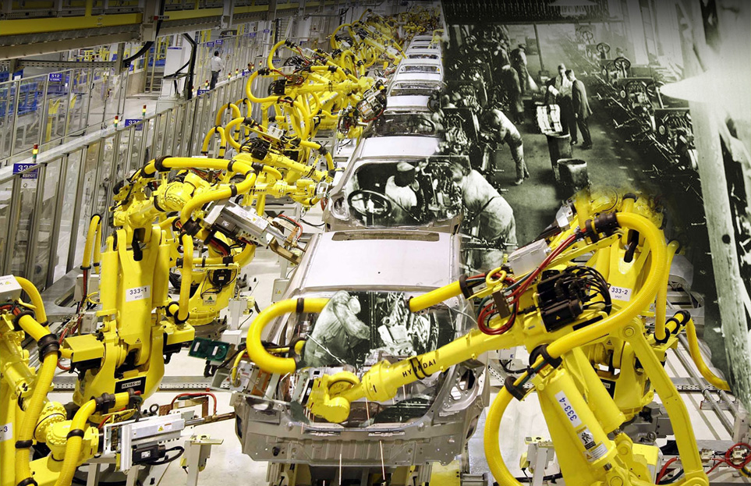
CEIT Group Introduction
… future accelerated …

Slide 2

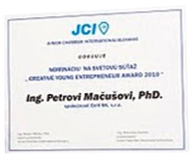

CEIT – Basic Facts
National leader in research and development of solutions for manufacturing and logistic systems
Basics of CEIT was formed in 1998
250 employees in 3 countries in Central Europe
15 mil. EUR revenues (2014)
Main orientation on automotive industry, expanding to other industries, for example area of robotics, healthcare...
Mechanical Product
of the Year
Mechanical Industry
Union SR
Creative Young
Entrepreneur Award
Junior Chamber
International Slovakia
Innovative Act
of the Year
Ministry of Economy SR

Slide 3
CEIT Group - Milestones
preliminary training and project activities in increasing productivity,
planning and production management and logistics
beginning of cooperation with Japanese International Co-operation Agency, the effect of the Japanese expert – Mr. Isao Matsuda in Slovakia
holding transformation,
establishment of
joint-stock company
CEIT, a.s.
establishment
of CEIT basics
establishment of division
CEIT Technical Innovation
expansion of the portfolio
CEIT Materials Engineering
... future
accelerated …
1998
1999
2000
2005
2007
2009
2013
2014
establishment of division
CEIT Consulting
formation of
CEIT Engineering Services
gaining membership in
European Association of
National Productivity Centres
Expansion of the portfolio
CEIT Biomedical Engineering

Slide 4
CEIT Group - structure
CEIT, a. s.
Central European Institute of Technology
CEIT Consulting, s.r.o.
Process Innovation
CEIT Engineering Services, s.r.o.
Product Innovation
CEIT Technical Innovation, s.r.o.
Technical Innovation
CEIT Biomedical Engineering, s.r.o.
Implants
CEIT Materials Engineering, s.r.o.
Sapphire
Digital Factory
Industrial Automation
Manufacturing and logistic systems
Healthcare
Materials
CEIT Academy, s.r.o.
Education
CEIT CZ, s.r.o.
Czech Republic
CEIT PL, Sp. z o.o.
Poland

Slide 5






















CEIT Group - partnership
Universities:
National organisations:
International organisations:

Slide 6

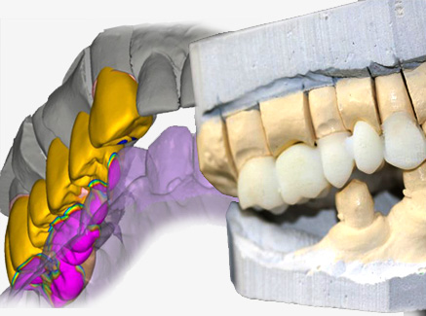

Solutions Overview
Manufacturing and Logistic Systems | Biomedical Engineering | Materials Engineering
Product Innovation Manufacturing System Design Process Innovation Industrial Automation Technical Innovation | Implant production Kranial Maxilo-facial Kranilo-maxilo-facial | Sapphire monocrystal Technology development System development

Slide 7
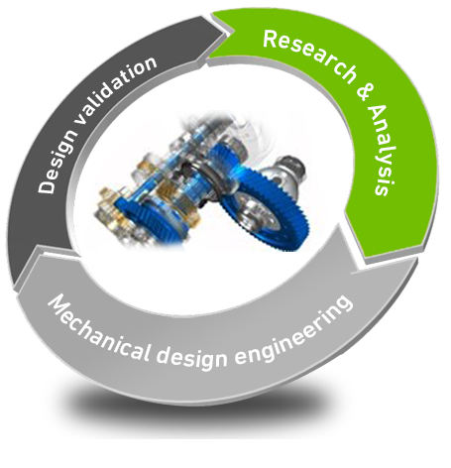
Product Innovation
Product Engineering for:
automotive, transportation and consumer goods industries
Rapid Prototyping
Simulations
3D digitization
Testing
Noise & Vibration analysis
Deformation analysis
Dynamic behavior analysis
Value engineering
Reverse engineering
Detailed component and
system design
Design optimization of existing products
Conceptual design
Feasibility study
3D part modeling
CAD Conversion
CAD Cataloging

Slide 8
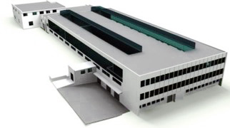
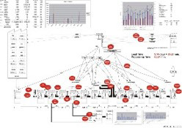
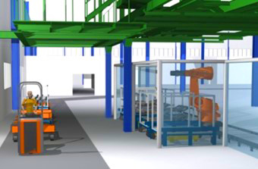
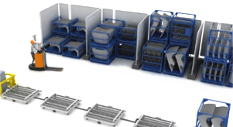
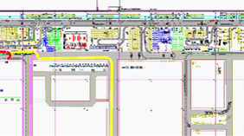
Manufacturing, logistic, services
Layout digitisation
Workplaces digitisation
Detailed workplace design
Interactiave layout design
Detailed layout design
Detailed process design
Sumarisation of
the requirements
Statical capacity
calculation
Analyses of the
core process
Analyses of the
supported processes
Value stream mapping
Visualisation of designed system
Visualisation of proceses
Visualisation of information flows
Virtual showing of new
system
Education movie
creation
Conceptual design
Modeling of
designed system
Simulation of
designed system
Optimisation of
designed system
System Design

Slide 9

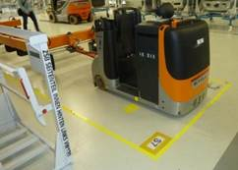
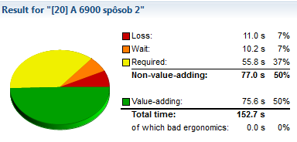
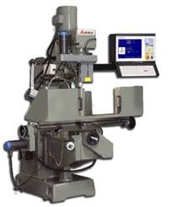


Process Innovation
Production Planning & Management
  Internal Logistics Planning, Industrial engineering systems, Pull Systems
Material flow management
  Internal Logistics, Warehouse management, Inventory Optimization & Management, Supply Chain, Procurement and Distribution
Productivity Improvement for production and non production proceses
  Work measurement and analyses, Continuous improvements, Ergonomics improvements, Standardization
Care about Machines & Equipments
  TPM, Autonomous maintenance, Planned maintenance, Preventive maintenance, 5S, OEE, SMED
Human Resources management
  Human resources development, reward and motivation systems, Building and Leading Advanced Teams
Quality assurance processes
  Quick Quality Design, Analyzing and solving of poor quality, Quality tools, Black and green belt training programs

Slide 10
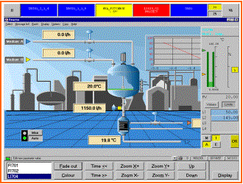
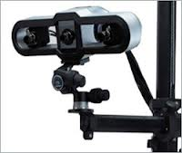
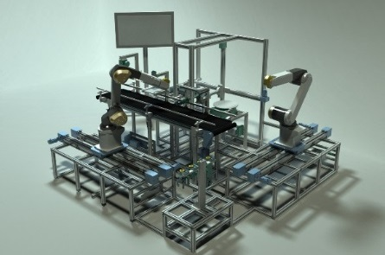
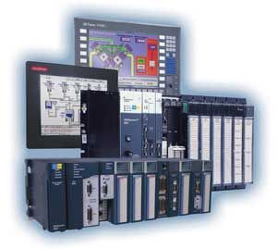
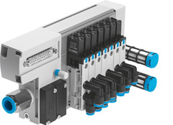
Industrial Automation
Design and development of SCADA and HMI systems
Industrial image processing systems - 2D, 3D
Design and development of
single and multi-purpose devices
Design of pneumatic and hydraulic systems
Programming of control systems - PLC, PPC
Off-line and on-line programming of robots

Slide 11
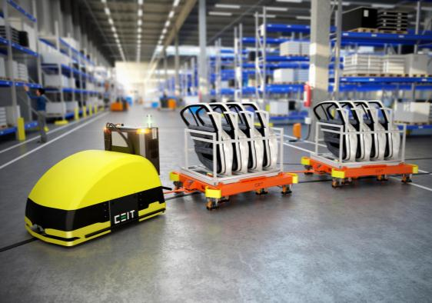
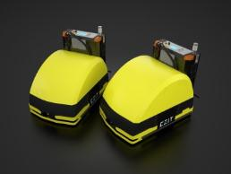
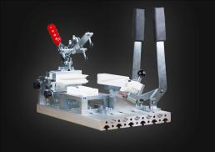

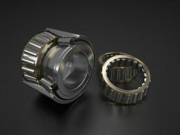
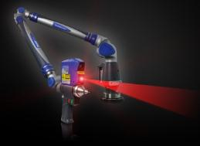
Technical Innovation
Product portfolio
Development of Innovative
Solutions within Automated
Logistics (AGV systems).
Optimization, Technical
and Economic Assessment
of Bearing Units.
Dedicated Fixtures
and Equipment,
Reverse Engineering.
Machinery Productivity
Monitoring and Unique
Software and Hardware Solutions.
„Innovation in motion“

Slide 12
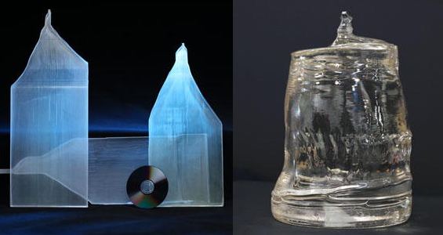
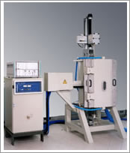
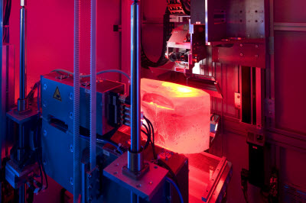
Materials Engineering
The main area of action is to research advanced technologies for growing of large single crystal sapphire.
Fields of activities:
Research and development activities
in the field of single crystal and their technologies.
Research and development facilities
for their production.
Project´s activities.
Supply of higher technology units.

Slide 13
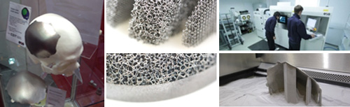
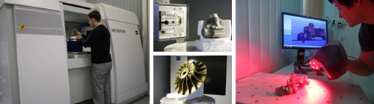
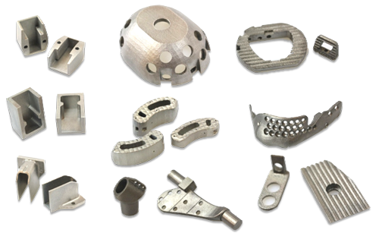
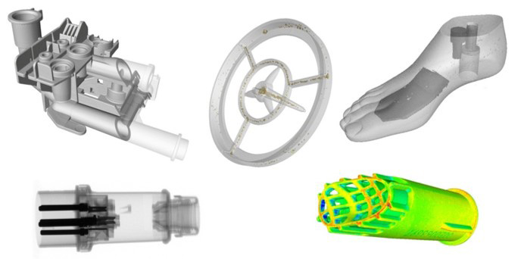
Biomedical Engineering
Custom-made medical device production
Laser sintered titanium devices production
DICOM data transformation and modelling
SIEMENS USG retail partner
Industrial tomography
Scanning and digitalization
Reverse engineering
Porosity analysis, wall thickness and measurement

Slide 14
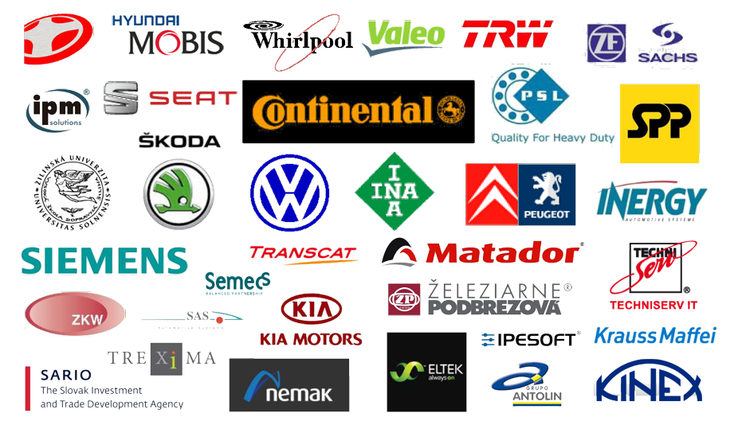
Chosen References

Slide 15
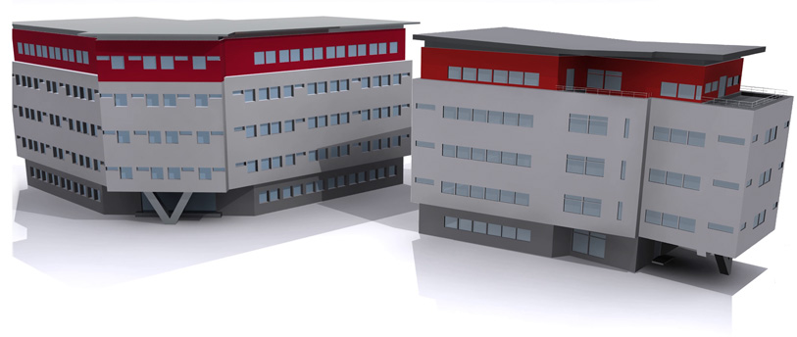
Thank you for your attention
CEIT, a. s., Univerzitná 8661/6A, 010 08 Žilina, Slovak Republic
Tel.: +421 41 513 7401 E-mail: ceit@ceitgroup.eu

