Slide 1
The Visegrad Patent Institute (VPI)
The role and tasks of VPI
Ľuboš Knoth,
President of the Industrial Property Office of the Slovak Republic
www.upv.sk

Slide 2
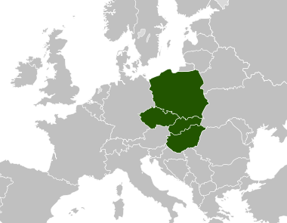
Vision
Strong political will to support innovations within the Visegrad Group (V4)
Long-established and developed cooperation of the patent offices
Missing international search authority in the CEE region
Focus on patent quality
Economic growth impulse

Slide 3
Definition
VPI is an intergovernmental organization for cooperation in the field of patents established by the four Visegrad countries (CZ, SK, H, PL)
The Agreement on the Visegrad Patent Institute was signed in Bratislava on 26 February 2015 by heads of the four national IP offices, as the duly authorized representatives of their governments.
The national ratification procedures are finalised in SK and H (in CZ and P expected soon)
The structure of the VPI follows the already existing and successful model of the Nordic Patent Institute (NPI): the governance of the VPI will be ensured by its Administrative Board and the VPI’s Secretariat headed by the Director will be responsible for the organization, day-to-day management and administrative support

Slide 4
Role
The VPI will act as the International Searching Authority (ISA) and International Preliminary Examining Authority (IPEA) under the Patent Cooperation Treaty (PCT)
For applicants from the V4 countries (and from some adjacent countries as well, like Lithuania and Romania) VPI will provide search reports and preliminary opinions on the possibility to obtain a patent for their invention
It is planned that VPI will also offer international-type searches and supplementary international searches

Slide 5
Goals
The VPI will serve the goals of fostering innovation and creativity as well as promoting economic growth and competitiveness in the CEE region. To achieve these goals, the VPI is intended:
to offer applicants a favorable and efficient option for entering the PCT system (through the possibility of using local languages and with proximity to users, SMEs, individual inventors and the like); and
to maintain, and further develop, the patent-related expertise of the participating patent offices at the service of their inventors and industries

Slide 6
Benefits
Communication in native languages of applicants will be their big advantage
It is expected to reduce costs associated with fees for PCT applications by 25 % for businesses and 37 % for individuals, which should contribute to increase international patent filing activity
The VPI will use existing capacities of national patent offices appropriately, therefore no new administrative obstacles arises

Slide 7
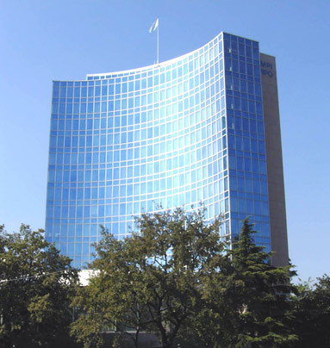
Next steps
October 2015 - appointment of the VPI as the ISA and IPEA by the Assembly of the International Patent Cooperation Union within the World Intellectual Property Organization (WIPO)
July 2015 - VPI starts of providing its services to the public
A big amount of work to be done yet ...

Slide 8
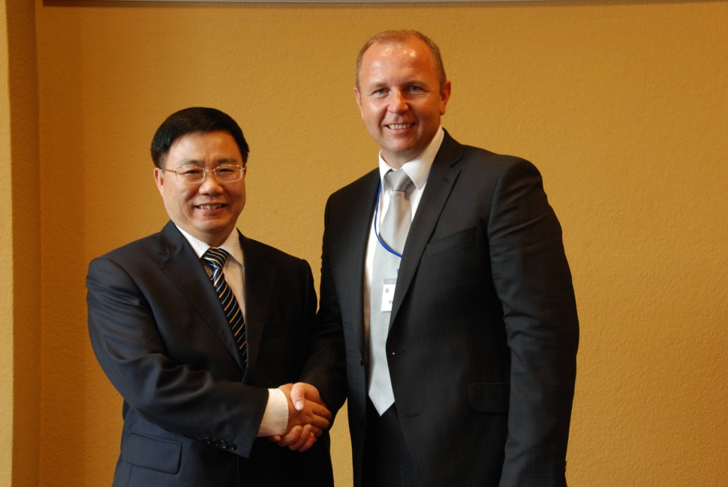
Chinese - Slovak partnership
On 9 September 2014 the President of the Industrial Property Office of the Slovak Republic (IPO SR) Mr Ľuboš Knoth met the Deputy Commissioner of the State Intellectual Property Office of the People Republic of China (SIPO) Mr He Zhimin in Prague on the occasion of the 95th Anniversary of Establishment of the Patent Office in former Czechoslovakia.

Slide 9
Future IPO – SIPO relations
Ľ. Knoth briefly introduced the history of the IPO SR, its services and future goals in order to provide sufficient information on the situation in the area of the industrial property in Slovakia
Mr He Zhimin introduced the history of the SIPO in its four stages.
He Zhimin said that despite of considerable development the system of the intellectual property in China has been relatively young and therefore the SIPO would welcome co-operation with the IPO SR. Mutual exchange of experience could enhance both Offices.
The representatives of the IPO SR and SIPO mutually invited themselves to the business visit and made an agreement that their Offices will be in contact.

Slide 10
Thank you for your attention!
Ľuboš Knoth
President
Industrial Property Office of the SR
lubos.knoth@indprop.gov.sk
www.upv.sk
Meno
2nd Symposium on Innovation, cooperation and international transfer of technology, China+16 CEEC Format, September 21-23,2015, Slovakia

