Slide 1


National Support System for Technology Transfer in Slovakia
SLOVAK SCIENTIFIC AND TECHNICAL INFORMATION CENTRE (SSTIC)
Jan TURNA
Bratislava, September 21, 2015
2nd Symposium on innovation, cooperation in technology and international TT

Slide 2





SSTIC’s main mission
National information centre and specialized scientific library
Operation of state systems and registries in the field of science
(SK CRIS, Publication Activity, Antiplagiarism system, …)
Technology transfer centre with nation-wide operation
Patent Library Bratislava – PATLIB, dep. library of OECD, EBRD & WIPO
National Point of Reference for OpenAccess to Scientific Information
National Centre for Science and Technology Promotion
Information and prognoses in Education
Network of National Contact Points for HORIZON 2020
Slovak Liaison Office for R&D in Brussels (SLORD)

Slide 3




TECHNOLOGY TRANSFER SUPPORT AT NATIONAL LEVEL

Slide 4



National infrastructure for technology transfer support in Slovakia – NITT SK
http://nitt.cvtisr.sk
OBJECTIVE
Creation and implementation of national system for support of RTD results application in social and economic praxis
IMPLEMENTATION
June 2010 – October 2015
BUDGET
8 234 571,17 €
Supporting research in Slovakia / Project co-financed from the EU funds

Slide 5


TT Support Services
http://nitt.cvtisr.sk
Raising awareness on IP rights and technology transfer
Provision of support services to scientific community in the process of IPR protection and commercialization
Partner search and marketing of technologies
Promotion of Slovak R&D organisations, their competencies and research results
Assistance in the process of TTO establishment at universities and R&D institutions and their methodical support

Slide 6
TT Support Outcomes
http://nitt.cvtisr.sk
TT support main figures (since 2013)
Contracts on provision of TT support services signed with more than
20 academic institutions
More than 100 patent applications supported (national, European, PCT)
IP Commercialisation strategy development, partner search, technology marketing and contracts’ drafting (around 200 cases supported)
Success stories examples
Biologically degradable polymeric composition with high deformability Polymer Institute, Slovak Academy of Sciences
AMOS - Modular automatic system for monitoring of moving sky objects Faculty of mathematics, physics and informatics, Comenius University in BA
A Simple Electrochemical Method of a LiFeAs Superconductor Preparation OHIO STATE UNIVERSITY + Technical University in Košice

Slide 7
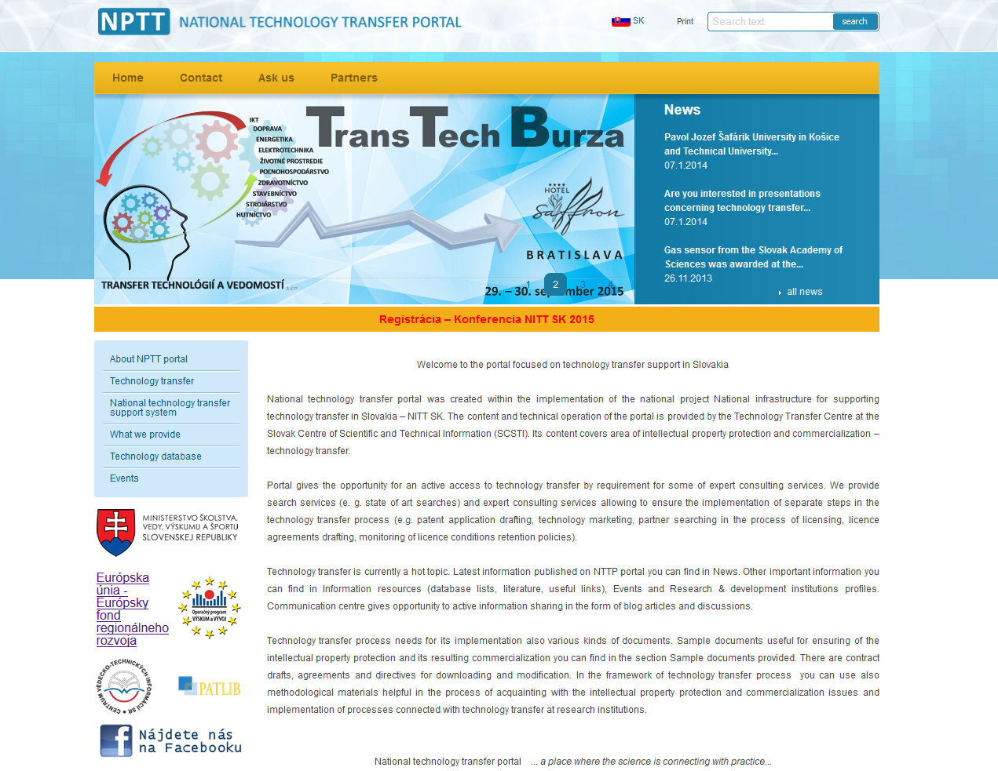
WWW.NPTT.SK

Slide 8
NATIONAL TECHNOLOGY TRANSFER CENTRE
Association of public research organisations (without legal personality)
Formed by
  Slovak Scientific and Technical Information Centre
  Slovak Academy of Sciences
  7 main Slovak universities (2 Bratislava; 2 Kosice; Nitra; Zvolen; Zilina)
Main mission
  Provision of support services to Slovak public research organisations
  in area of IP protection and commercialization
  PATENT FUND administration
  Improving conditions (including legal framework) for technology transfer
  in Slovakia
Supporting research in Slovakia / Project co-financed from the EU funds

Slide 9

NATIONAL BUSINESS CENTRE in co-operation with Slovak Business Agency
NATIONAL BUSINESS CENTRE
Support of existing, new and potential entrepreneurs, including start-ups & spin-offs creation
Enhancing the R&D co-operation of academy and industry
Consultancy in area of IP protection and commercialization
COMPLEX SUPPORT TO SMES FROM A SINGLE POINT:
Supporting research in Slovakia / Project co-financed from the EU funds

Slide 10
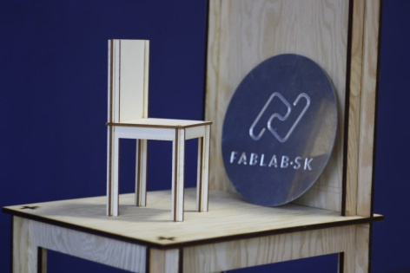

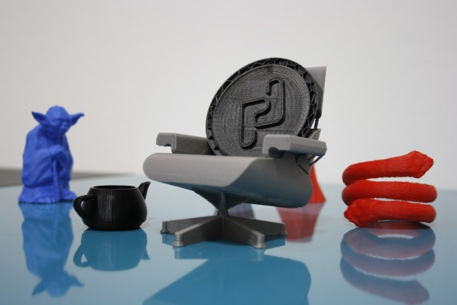
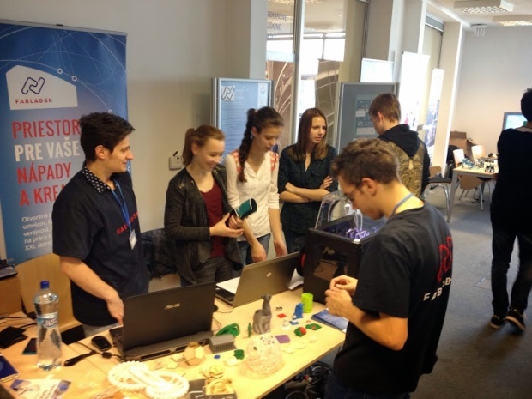
NATIONAL BUSINESS CENTRE
SPACE
FOR YOUR
IDEAS AND CREATIVITY
Bratislava municipality
Slovak Scientific and Technical Information Centre
French institute in Slovakia
Faculty of Informatics and Information Technologies STU
Open platform for designers, artists, students and general public, offering the space for working with technologies of Xxi, century.

Slide 11

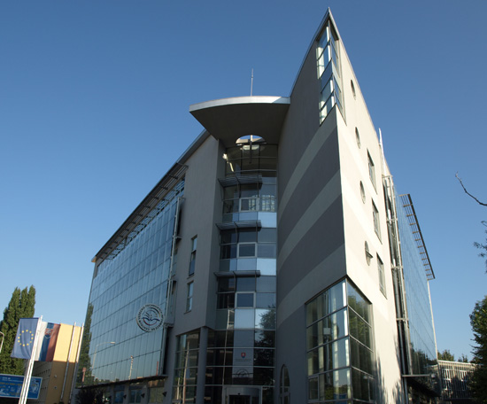
CONTACT
CVTI SR
Lamacska cesta 8/A
811 04 Bratislava, Slovakia
prof. Jan TURNA, PhD.
director general
Tel: +421 2 69253 103
Fax: +421 2 69253 180
E-mail: cvti@cvtisr.sk
www.cvtisr.sk

