Slide 1
Digital Economy
New Challenges and Opportunities
from the point of Information Security
Ing. Petra Hochmannová – csirt.sk

Slide 2
„Digital Economy refers to an economy that is based on digital computing technologies“ wikipedia.com
The existing business models are gradually transformed.
Trends like mobile technologies, cloud computing, big data, business intelligence and social networks have not only released innovation potential in businesses and public administrations, but have also successfully generated customers’ pressure for the price, quality and availability of services.
Digital Economy
Expectations

Slide 3
The cost of cybercrime will continue to increase as more
business functions move online.
Losses from the theft of intellectual property will also
increase as acquiring countries improve their ability to make
use of it to manufacture competing goods.
Cybercrime is a tax on innovation and slows the pace of
global innovation by reducing the rate of return to innovators
and investors.
Governments need to begin serious, systematic effort to
collect and publish data on cybercrime.
Information security
Challenge

Slide 4
Zdroj: Mcaffe report 2014
Impact of the Cybercrime
Global Perspective

Slide 5
Incident reporting trend
Impact of the Cybercrime
Slovak Republic

Slide 6
National Strategy for Information Security in the Slovak Republic - 2008
Action plan to the National Strategy for Information Security – 2009 – 2013
Cyber Security Conception in the Slovak Republic – 2015:
Focus areas:
Information security planning and governance
Prevention
Capacity building
Awareness rising
National and international cooperation
Reaction
Defence, Offence, Intelligence
Recovery
NEW
Impact of the Cybercrime
Slovak Republic

Slide 7
Information Security
Opportunities

Slide 8
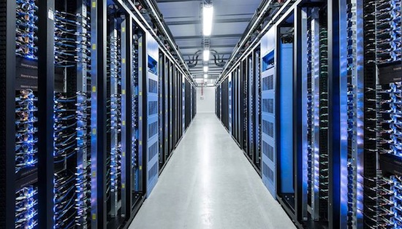
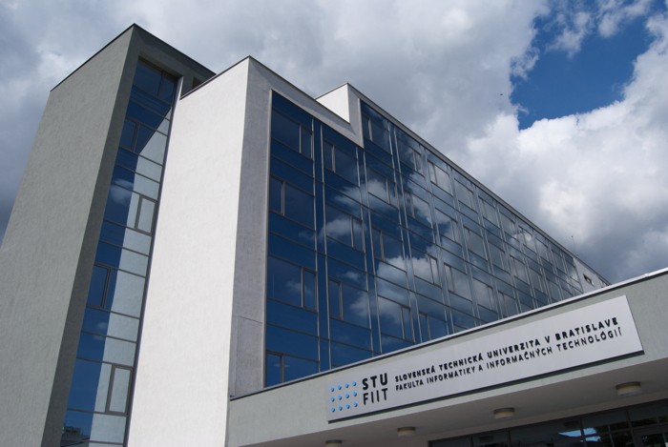
Research, Development and Innovation
Centrum of Excellence

Slide 9
Public-private partnership dedicated to accelerating the regional economy:
Fostering cooperation throughout the established cyber community, attracting and nurturing talent and creating new opportunities
Cluster: Resource for cyber knowledge and expertise
Collaboration: Connecting academia, stakeholders and cyber security community
Progress: Promoting cyber related issues, ideas and organizations to advance the regional economy
Execution-Oriented: Delivering timely and relevant content, programs and networking opportunities
Knowledge Hub: Independent, fact-based, credible source information
Research, Development and Innovation
Centrum of Excellence

Slide 10
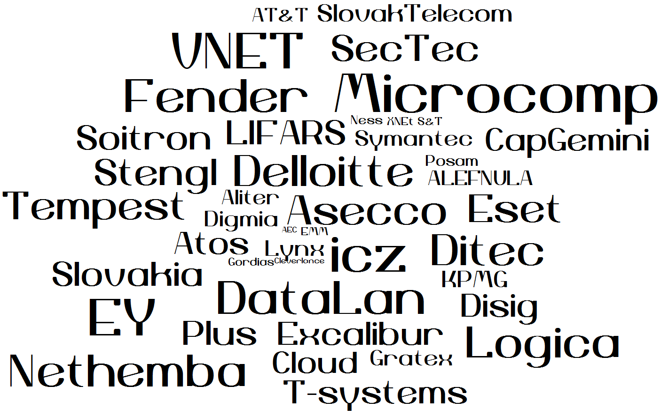
Private Sector
Cyber security Ecosystem

Slide 11
CSIRT.SK
DataCentrum
Cintorínska 5, 814 88 Bratislava
www.csirt.gov.sk
tel: 02 59 278 205, 02 59 278 454
e-mail: info@csirt.gov.sk
incident@csirt.gov.sk

