Slide 1




NBN 2020:
A Better Connected Nation
Notes:
.借用公司年度主题building a better connected world, 以国家宽带为开端实现这个愿景。

Slide 2
2020 will see a better connected life…
Notes:
趋势：
根据ITU2014年报显示，全球已有140个国家发布国家宽带计划，宽带已经成为国家发展战略的重要组成部分
在21世纪，无处不在的宽带将如水，电，交通一般对社会，经济发展至关重要，带宽将成为新能源中的”black gold”

Slide 3
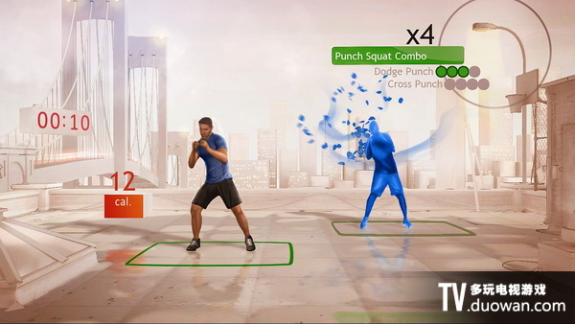


Foundation
for
Quality Life
Foundation
for
Industry 4.0
UHD-Video Life
Industry 4.0
Better Than Life
Everything On Video
  Intranet → Industrial Internet
Video Internet
  Vertical → Vertical + Horizontal
Self-Optimization
  Industry 4.0
Self-Configuration
Live TV
Self-Diagnosis
Game
Education

Slide 4





ITU: Connect 2020
140
55%
90%
30%
Key
Countries with NBP
Broadband to households
Broadband to the rural population
Decrease Gas emission by ICT sector
ICT environment conducive to innovation
Notes:
趋势：
根据ITU2014年报显示，全球已有140个国家发布国家宽带计划，宽带已经成为国家发展战略的重要组成部分
在21世纪，无处不在的宽带将如水，电，交通一般对社会，经济发展至关重要，带宽将成为新能源中的”black gold”

Slide 5
10% Broadband Penetration = +1.3% GDP
10%↑ Broadband Penetration = 1.38%↑ GDP
GDP
+1.3%
Innovation efficiency
15x
New Jobs +2-3%
10%
Broadband Penetration
CO2 Emission
-5%
Productivity +5-10%
Source: Technologies Department, World Bank
Source: McKincy , Booz&Co , Broadband Commission
Notes:
价值：
在通讯产业中，宽带相比固定语音，移动语音，互联网等技术对国家GDP的贡献更为突出。
每10%的宽带渗透率的提升将带动1.3%的国家GDP增长，并创造更多就业岗位，提升生产效率。

Slide 6

A Study of Malaysian National Broadband Initiative
“Innovation Economy: Paving the Way to Prosperity"
--- DATO’ SRI MOHD NAJIB TUN ABDUL RAZAK
Prime Minister of Malaysia
67.1%
Supply
Demand
Internet penetration rate
1Malaysia Wireless Village
21.1%
Tax
Reduction
4,679
Villages
BBGP
2+ Mbps
424
centers
10+ Mbps
1Malaysia
Internet Centre
10538.1
e-public
services
1.1 Million
Sets
HSBB
GDP Per Capita Change
1Malaysia Netbook
7277.8
Malaysia National broadband Initiative was launched from 2009
Source: Malaysia USP report, World bank
Notes:
马来西亚案例:
为促使马来西亚向创新经济转型，引领马来西亚经济繁荣，2009年马来西亚总理（DATO’ SRI MOHD NAJIB TUN ABDUL RAZAK）发布了国家宽带计划
该计划从基础设施建设与需求激发两方面同时着手，仅仅4年时间，全国互联网渗透率提升35个百分点，使在世界金融危机中受影响的马来西亚经济得以快速恢复/增长。

Slide 7

A Study of Broadband China Strategy Practice
FBB subscribers
31.8% CAGR increase
Broadband China
Telco Revenue
1000 times in 30 years
National Strategy Start from 2007
Telco First
7 X 5-year Plan
Fiber-From-The-Home
Bandwidth Test Platform
Internet Company
BAT in world top 10
Investment Return
3.38 times
Notes:
宽带中国战略实施后中国电信产业快速发展，对整个经济社会形成支撑。3.38倍投资回报，是指ICT相应投资获得比传统产业投资更高的收益回报

Slide 8
NBN 2020: A Better Connected World for Citizens
Higher Speed: 25Mbps ~ GigaBand
Full Coverage: >99%
Everything Connected: >Person, Premise
Notes:
趋势：
根据ITU2014年报显示，全球已有140个国家发布国家宽带计划，宽带已经成为国家发展战略的重要组成部分
在21世纪，无处不在的宽带将如水，电，交通一般对社会，经济发展至关重要，带宽将成为新能源中的”black gold”

Slide 9
NBN 2020
An Enabler of
infinite innovations
A Society embracing
new applications, business models and industries
A Space where
every heart & soul connects

Slide 10

How to WIN NBN 2020?
GigaBand@Anymedia
Differentiated Driven Measures for Coverage
Investment-friendly Regulations
Easy Access to Non-Telecom Infrastructure
15

Slide 11


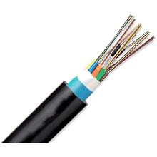

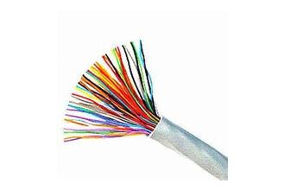


Gigaband: Any Media Ready for Giga
ODN + Engineering = 70% total cost
PON
10G PON
DOCSIS 2.0
DOCSIS 3.0
Any media
DOCSIS 3.1
GigaBand
Supervector
G.fast
ADSL
VDSL
Hybrid
LTE+DSL
LTE+SuperVector
14
Notes:
So, what kind of broadband technology should we choose?
As the pipeline and engineering costs more than 70% of the total investment, to fully re-use the existing media resources is vital, for cost saving.
Nowadays, you can achieve Gigabit-level of bandwidth through any kind of media, such as fiber, copper, cable, and Hybrid.

Slide 12


Differentiated Driven Measures for Coverage in UK
2/3 of population
in dense area
Next-Gen Access(NGA)
NGA 2.0
Marketing Driven Coverage
Profitable
BT invested £2.5B
Sharable via Bitstream
500Mbps
1/3 of population
in rural area
Broadband Delivery UK(BDUK)
Hybrid Bonding
Policy Driven Coverage
Non-Profitable
2Mbps+ Universal Service
Gov. Subsidies (1:1:2)
LTE+Fttx (500Mbps)
Notes:
一种恰当，合适的投资方式将是成功的关键。国家宽带的部署离不开承接实体，这里以Arthur D. Little的咨询报告指出目前存在的5种国家宽带建设模式。
三维坐标图从performance, coverage, competition三个层面定位5种模式的利弊。
球体越大代表政府投入的资金越多，从体积上看，第1,5,4种最省钱。从peformance看，1和2最高效，从覆盖范围看第3种最有效，从开放竞争角度看第3,4最有效。但综合来看，第1,2种最均衡，无论是performance和coverage都处于领先，唯独开放竞争上需要更好的监管支撑。而第1,2种模式其实就是业界主推的PPP模式，其中第1种被众多国家选择的正是PPP+固网一牌的投资建设模式。

Slide 13


Investment-friendly Regulations to Boom Broadband
Poland UKE
ILEC
Oct 2014
announce deregulating for open access in 76 municipalities
5 Provinces in 2014
Notes:
Polish watchdog eases broadband regulation in 76 municipalities
Poland’s Office of Electronic Communications (UKE) has decided to ease the regulation of wholesale broadband internet access services in 76 municipalities across the country as it says there is now sufficient competition in these markets. The watchdog conducted an analysis of the competitive situation in all 3,000 municipalities nationwide and found that in the vast majority of these the incumbent operator Orange Polska (formerly Telekomunikacja Polska) still retains a dominant position and will therefore be subject to ongoing regulation to help promote healthy competition.
In the 76 de-regulated markets, however, UKE found that the internet sector had met four key conditions: Orange’s retail broadband market share was below 40%; the area had at least three active broadband internet service providers (ISPs); over 65% of premises had access to the infrastructure of at least three competing operators; more than 90% of premises had access to at least one broadband service. UKE says lifting the regulation on Orange will encourage the incumbent to increase investments in its broadband infrastructure. Poland was home to more than 5.6 million high speed internet subscribers at the end of June 2014, according to TeleGeography’s GlobalComms Database.

Slide 14








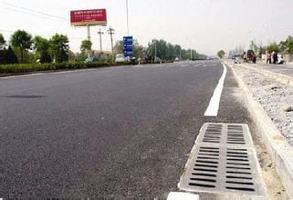

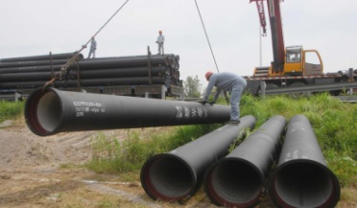
EANTI: Easy Access to Non-Telecom Infrastructure
Croatia
Poland
Electricity
Highway
Railway
Motorway
Crude oil
Road
Natural gas
30 years contract
~8000km open access network
14% CAPEX saved
12 months TTM ahead

Slide 15

NBN 2020
A Better Connected Life

